Slide 1
Binary tree traversals
Exercise 1:
preorder Traversal(VLR ):
inorder traversal(LVR ) :
postorder traversal(LRV):
Level Order traversal :
+
*
5
2
4

Slide 2
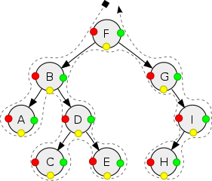
Binary tree traversals
Exercise 2:
preorder(VLR )
inorder(LVR )
postorder(LRV)
F
7
25
A
0
7
A
0
7
7
25
1
9
10
29
8
7
15
25
35
0
3
10
10
17
30
2
5
4
6

Slide 3
Binary tree traversals
Exercise 3:
preorder(VLR )
inorder(LVR )
postorder(LRV)
G C B D A F E
7
25
G C B D A F E
0
7
G C D B F E A
0
7
A
B
E
C
D
F
G

Slide 4
A
A
B
E
B
D
C
D
F
C
G

